Slide 1
The Passive Sign Convention

Slide 2
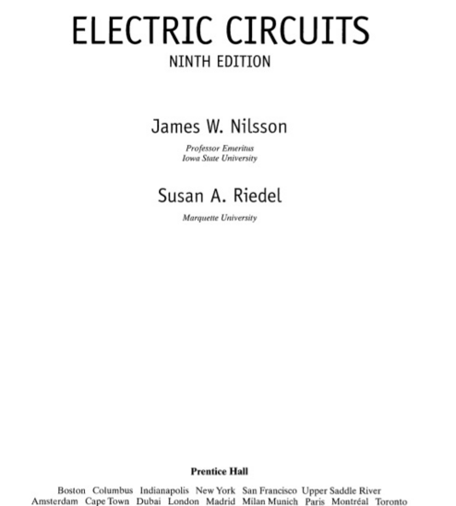
http://www.slideshare.net/03026319643/electric-circuits-9th-edition-by-james-w-nilsson-susan-riedel-47990834

Slide 3
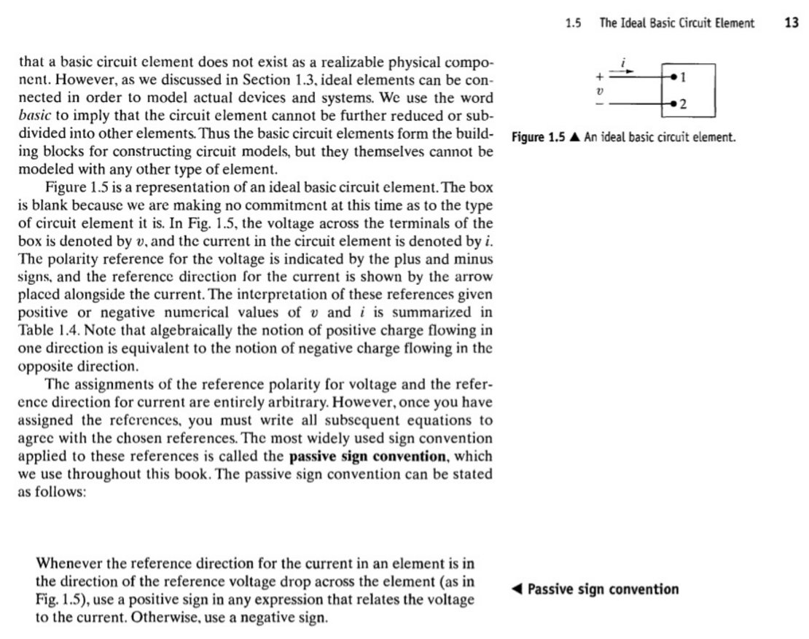
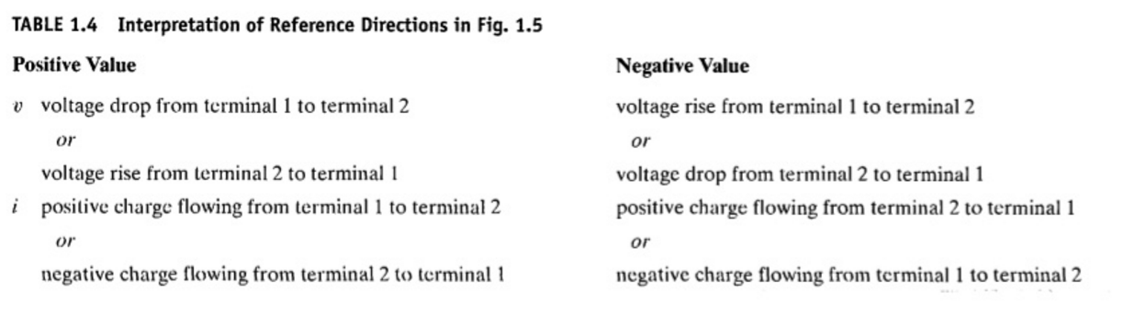
http://www.slideshare.net/03026319643/electric-circuits-9th-edition-by-james-w-nilsson-susan-riedel-47990834

Slide 4
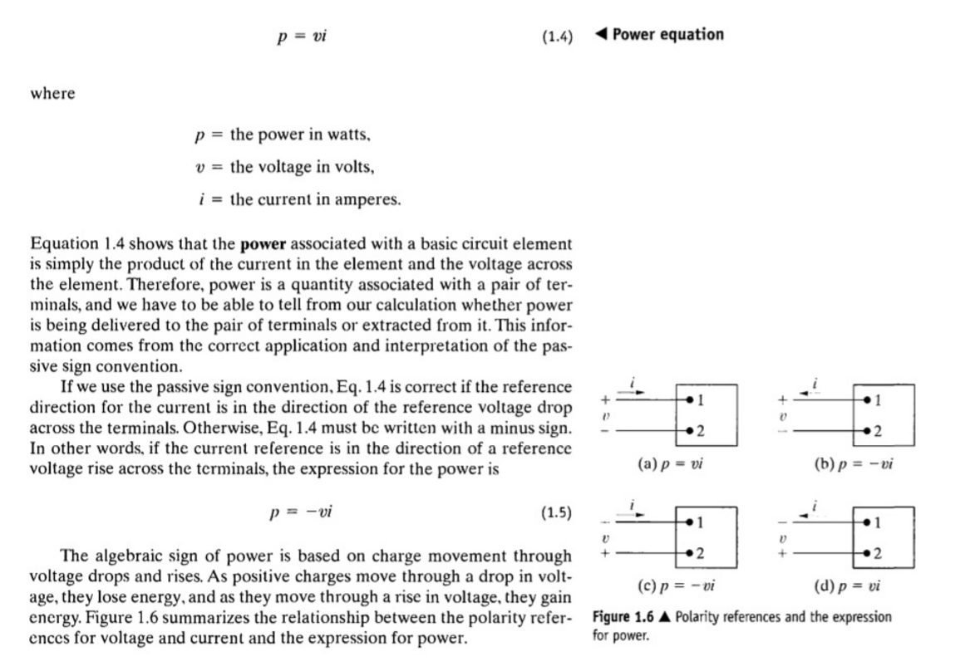
+
−
+
−
+
−
+
−
http://www.slideshare.net/03026319643/electric-circuits-9th-edition-by-james-w-nilsson-susan-riedel-47990834

